Slide 1
SSD In-Storage Computing for List Intersection
Conference : DaMoN '16
Author : Jianguo Wang, Dongchul Park, Yang-Suk Kee, Yannis Papakonstantinou,
Research unit : University of California, San Diego, Samsung Semiconductor Inc

Slide 2
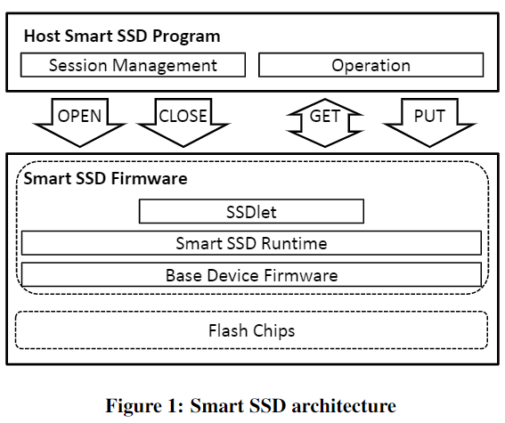
Research work—Background
Figure 1 describes the architecture which consists of two major components: Smart SSD firmware and host Smart SSD program. The Smart SSD firmware is divided into three components:
An SSDlet is a Smart SSD program running inside the SSD. It implements application logic and responds to a Smart SSD host program.
The SSDlet is executed in an event-driven manner by the Smart SSD runtime system, which implements the libraries of Smart SSD APIs.
The base device firmware is developed to support normal I/O operations (like read and write) of a storage device.
Notes:
SSDlet：SSDlet是运行在SSD内部的智能SSD程序。实现应用逻辑，响应Smart SSD主机程序。
Runtime：SSDlet的运行时系统，以事件驱动的方式运行SSDlet，实现了Smart SSD的API库。
bdf：基本设备固件的开发是为了支持存储设备的正常I/O操作(如读和写)。

Slide 3
Research work—Background
The host Smart SSD program communicates with the Smart SSD firmware through APIs
OPEN: As the name suggests, it starts a session. Once a session is created, runtime resources such as memory and threads are assigned to run the SSDlet.
CLOSE: It terminates a session, and all the resources will be reclaimed.
GET: It is used to check the status of the SSDlet and receive the output results once they are ready.
PUT: it is used to internally write data to the Smart SSD device without help from any local file system.
Notes:
主机Smart SSD程序通过api与Smart SSD固件进行通信。有四个重要的api，分别是OPEN、CLOSE、GET和PUT。其中，OPEN和close是与会话相关的api，而GET和PUT是与操作相关的api。
(1) OPEN:顾名思义，开启一个会话。一旦创建了会话，就会分配内存和线程等运行时资源来运行SSDlet。
(2) CLOSE:结束一个会话，所有的资源将被回收。
(3)GET:允许主机Smart SSD程序与SSDlet交互。GET用于检查SSDlet的状态，并在输出结果就绪后接收它们。它为SAS/SATA实现了轮询机制(而不是中断机制)，这样主机程序必须持续监控智能SSD的状态。这是因为传统的块设备不能使用中断向主机发起请求。
(4) PUT:用于内部向智能SSD设备写入数据，不需要本地文件系统的帮助。

Slide 4
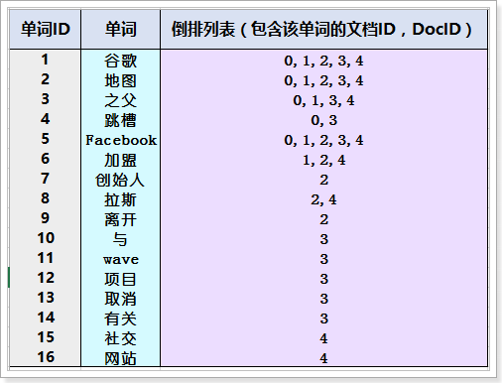
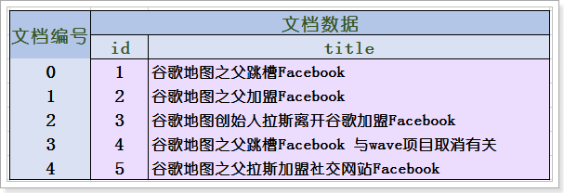
Research work—Background
An inverted index is a database index storing a mapping from content, such as words or numbers, to its locations in a table, or in a document or a set of documents.
It is the most popular data structure used in document retrieval systems used on a large scale for example in search engines.
Notes:
倒排索引，也常被称为反向索引、置入文件或反向文件，是一种索引方法，被用来存储在全文搜索下某个单词在一个文档或者一组文档中的存储位置的映射。它是文档检索系统中最常用的数据结构。例如，在搜索引擎中查找包含所有查询词的文档需要几个倒排列表的交集;

Slide 5
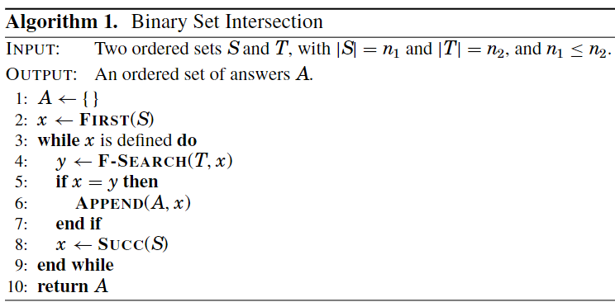
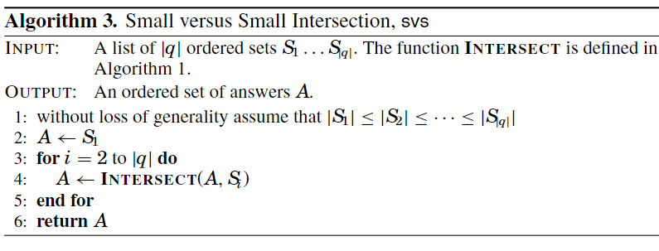
Research work—Background
FIRST(S): Return a pointer to the least element x∈S.
F-SEARCH(S, x): Return a pointer to the least element z ∈ S for which z ≥ x, where x is greater than the value of the current element.
SUCC(S): Return a pointer to the element in S that immediately follows the current one.
INTERSECT(S, T): Return the set S ∩ T.

Slide 6
Research work—Problem
In a conventional database architecture, solid state drives (SSDs) are treated as storage-only units.
Modern SSDs are usually manufactured with a higher (2-4×) internal bandwidth than the host interface bandwidth. The limited external bandwidth will squander the high internal bandwidth that SSDs provide.
If the database wishes to examine a piece of data to make a decision or execute a query, it must pull the data from SSDs through a (relatively) slow interface (such as SATA, SAS, or PCIe) into main memory where the CPU has access to it.
Notes:
现代ssd的内部带宽通常比主机接口带宽高(2-4×)以我们实验中使用的三星SSD为例，内部带宽为1.5 GB/s，而主机接口(SAS)带宽为550 MB/s。那么有限的外部带宽将浪费ssd提供的高内部带宽
如果数据库希望检查一段数据来做出决定或执行查询时，它必须通过一个(相对)慢的接口(如SATA、SAS或PCIe)将数据从ssd拉到CPU可以访问的主内存中

Slide 7
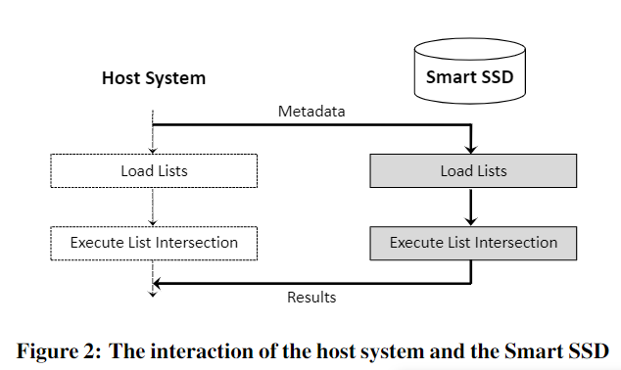
Research work—Solution & Technique
The host system sends some metadata (via OPEN) that is necessary to perform list intersection, for example the addresses and lengths of the lists.
The Smart SSD then starts to load data (lists) from flash chips to the device memory (DRAM) in pages (of 8 KB).
When all the lists are loaded to the device DRAM, the Smart SSD executes list intersection.
Once it is done, the results will be put to an output buffer and then returned to the host side.
The host system keeps monitoring the status of the Smart SSD to receive the intersection results in a heart-beat manner (via GET).
Notes:
主机系统发送一些元数据(通过OPEN)，这些元数据是执行列表交叉所必需的，例如列表的地址和长度。
然后，Smart SSD开始将数据(列表)从闪存芯片以页(8kb)的形式加载到设备内存(DRAM)。
我们为列表交叉保护了150 MB DRAM空间(但可以扩展)。注意，如果列表无法容纳设备DRAM，我们可以增加DRAM大小，或者像[27]那样对列表进行分区，以便每个分区都能容纳设备DRAM。在150mb的内存空间中，有256kb是可以与闪存直接通信的核心存储器(core memory)。也就是说，每一页都会先从闪存芯片上转移到核心存储器上，然后再复制到(相对)大的DRAM上。
当所有的列表加载到设备DRAM时，Smart SSD执行列表交叉。一旦完成，结果将被放置到输出缓冲区，然后返回到主机端。主机系统持续监控智能SSD的状态，以心跳(GET)的方式接收交叉结果。我们将轮询间隔设置为1 ms(出于性能原因)。

Slide 8
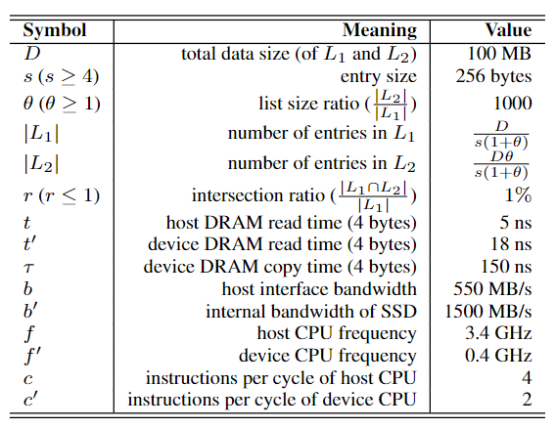
Research work—Evaluation
We divide the processing of list intersection into four main stages and analyze the cost of each stage individually.
Load data: Load each list individually from flash chips to memory.
Memory copy(only on Smart SSDs): Copy data from the core memory to the device memory.
Do intersection: When all the lists are ready, run the SvS algorithm for intersection on both Smart SSDs and regular SSDs.
Send results(only on Smart SSDs): After the computation is finished, send results back to the host.
Notes:
Load data 将每个列表分别从闪存芯片加载到内存。在智能ssd上，内存指的是设备DRAM，而在普通ssd上，内存指的是主机DRAM。
Memory copy 将数据从核心内存复制到设备内存。该阶段仅适用于Smart ssd硬盘，因为数据只能从闪存芯片加载到256kb的小核心内存中。这是三星智能SSD的实现问题，我们将在未来消除这一约束。但是，在普通的ssd上，数据可以直接从闪存芯片到主机DRAM，而不需要这样额外的数据拷贝。
Do intersection 当所有列表就绪后，在智能ssd和普通ssd上运行SvS算法进行交集。
Send Results 计算完成后，将结果返回给主机。此阶段仅适用于智能ssd盘。

Slide 9
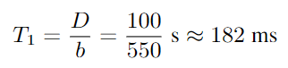
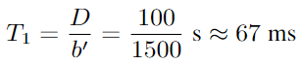
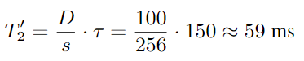
Research work—Evaluation
Cost of Loading Data
Regular SSD:
Actual: 192ms
Smart SSD:
Actual: 65ms
Cost of Memory Copy
Actual: 62.5ms
Notes:
分析表明，内部带宽(b′)是一个重要的影响因素。智能ssd的优势来自于高的内部带宽。一般来说，ssd是用更高的内部带宽制造的，以执行许多复杂的超光速任务。从目前的技术趋势来看，两者之间的差距(至少在近期内)还没有缩小的迹象。b ' /b是智能ssd可能实现的性能提升的上限。在本例中，该值为1500/550 = 2.73×。
<ID, payload> ID 4Bytes 回想一下，每个列表的条目都有表单< ID，有效负载>。但是，只有ID字段(4字节)用于交集。因此，在这个阶段，我们只将ID字段从核心内存复制到设备内存。注意，如果有效负载为空，则必须复制整个数据。

Slide 10
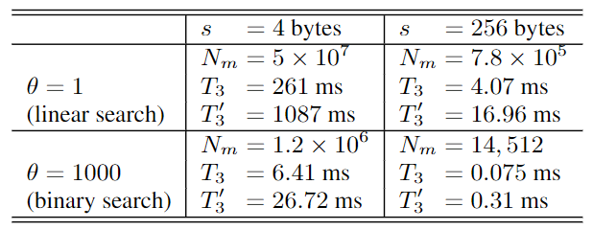
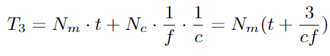
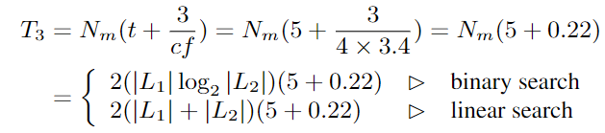
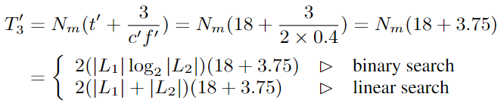
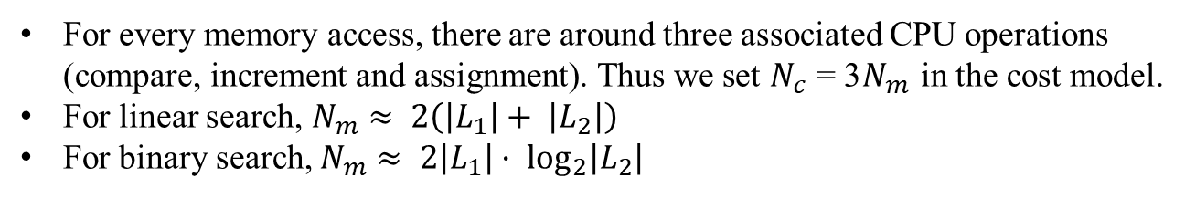
Research work—Evaluation
Cost of List Intersection
For every memory access, there are around three associated CPU operations (compare, increment and assignment). Thus we set $N_{c}$ = 3$N_{m}$ in the cost model.
For linear search, $N_{m}$ $≈ 2\left(\left|L_{1}\right|+ \left|L_{2}\right|\right)$
For binary search, $N_{m}≈ 2\left|L_{1}\right|· \log_{2}\left|L_{2}\right|$
Regular SSD:
Smart SSD:
Notes:
我们分析在内存中执行列表交集的代价,它涉及到不同的处理器(Intel CPU和ARM CPU)，它们有不同的架构。许多难以建模的因素，如乱序执行、深度管道和分支预测会影响性能。
在SvS算法中，对于每个内存访问，大约有三个相关的CPU操作(比较、递增和赋值)。因此，我们在成本模型中设Nc = 3Nm。
线性搜索时，Nm可估计为2(|L1| + |L2|)。我们将常数因子设为2，因为每次比较通常一次移动一个指针。二值搜索时Nm≈2|L1|·log2 |L2|。

Slide 11
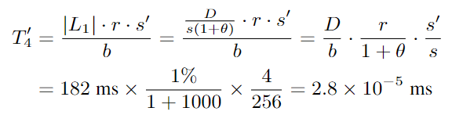
Research work—Evaluation
Cost of Sending Results to Host
Notes:
s’为ID的大小

Slide 12
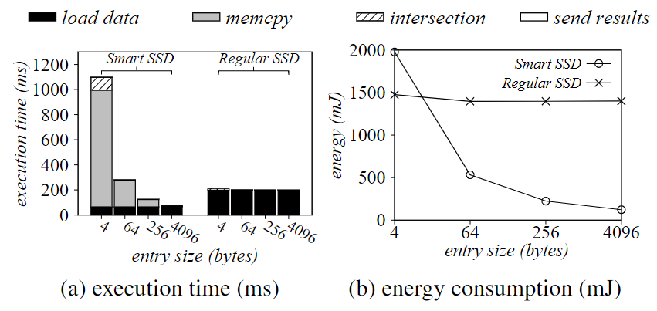
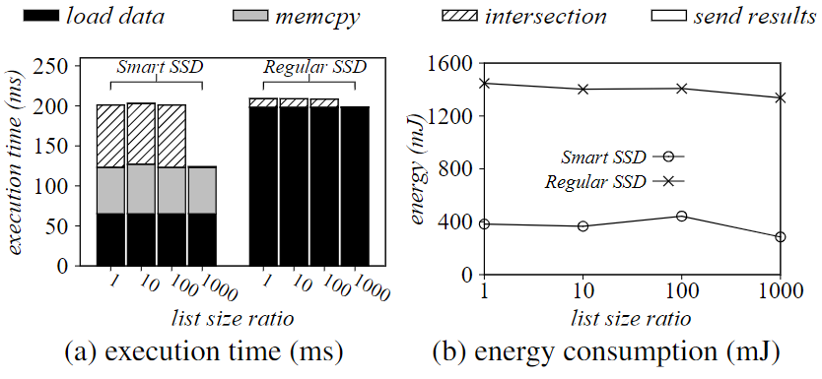
Research work—Evaluation
Effect of the Entry Size
Effect of the List Size Ratio
When s increases, the overhead of memcpy (also intersection) decreases because the number of entries decreases.
The energy consumption is roughly proportional to the execution time. But Smart SSDs consume much less power (energy/time).
A clear performance improvement whenθ increases from 100 to 1000 because search method change from linear to binary.
when s = 256, Smart SSDs can accelerate list intersection for any θ.
Set $L_{1} as 0.1MB, L_{2} as 100MB, intersection ratio r as 1\%$
Set total size of $L_{1} and L_{2} to be 100MB, r as 1\%$, s to be 256B
Notes:
我们设置L2的大小为100 MB, L1的大小为0.1 MB。这是因为在实践中，一个列表通常比另一个[10]长。我们设置交集比为1%，从4到4096变化s。图3绘制了结果。随着s的增加，执行时间和能量消耗都会减少，因为列表变得更短。图3a显示，智能ssd可以提高I/O性能。但是，当s很小的时候，内存复制的开销会很大。例如，当s = 4时，memcpy占总执行时间的85%。这是因为三星智能SSD没有缓存。因此，设备DRAM访问延迟是高的。当s增加时，memcpy(也是交集)的开销减少，因为表项数量减少。
我们设置fl1和L2的总大小为100 MB。我们将θ从1变化到1000，同时固定入口大小s为256字节，交集比r为1%。图4显示了结果。结果表明:(1)θ从100增加到1000时，性能有明显的提高。这是因为有效的数据跳过(使用二分搜索)。需要注意的是，当θ从1增加到100时，执行时间变化不大，这是因为采用了线性搜索。(2)当s = 256时，智能ssd在任意θ下都能加速列表相交。

Slide 13
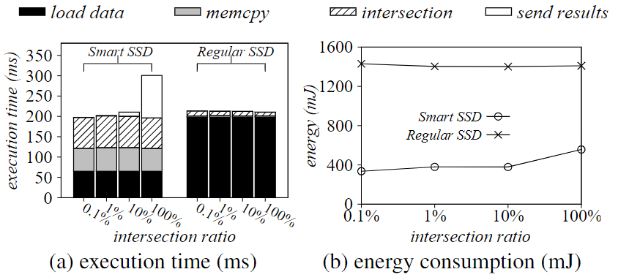
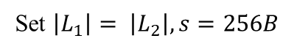
Research work—Evaluation
Effect of the Intersection Ratio
when r increases, the cost of sending back results to the host also increases on the Smart SSD.
However in some applications, if we only care about the intersection size instead of the actual intersection results, the cost of sending results back to the host will be almost free。
Set $\left|L_{1}\right|= \left|L_{2}\right|, s=256B$
Notes:
交集比例r的影响
当R增加时，向主机返回结果的消耗会变大 r不会影响常规SSD的性能，这并不奇怪。当r为100%时，智能ssd硬盘不能再加速处理
然而，在某些应用程序中，如果我们只关心交集的大小而不关心实际的交集结果，那么将结果发送回主机的成本几乎是免费的。这是因为只需要将一个4字节的整数传输到主机。

Slide 14
Research work—Conclusion
Factors that can affect the performance and energy of executing list intersection within Smart SSDs:
Device memory speed
Internal bandwidth
Entry size
List size ratio
Intersection size
Implications:
It is urgent to improve the memory access speed. To do so, SSD vendors can introduce more caches (both data-cache and instruction-cache) to SSDs.
Not all applications can benefit from Smart SSDs. They have to be I/O-intensive and computationally-simple. Also, the number of memory accesses should be small and the output size should be (much) smaller than the input size.
Notes:
智能SSD求交性能和耗能的影响因素：内存速度、内部带宽、条目大小、列表的比例、交集的大小
在SSD方面，应该尽快提高内存访问速度
在应用程序方面，I/O密集型和计算简单型程序可以从智能SSD中受益。同时访存数量应该较小并且输出大小需远小于输入

